Slide 1
Procedurally Generating Miniature Cities in Unity
Using fast variable density Poisson-disc sampling
Notes:
Basically I found this particular programming in my free time while looking into something for my own game, it's interesting and wanted to challenge myself to explain it to you.
I also decided to wrap it up inside a scenario that should hopefully give us context to why we would use it, and having a visual should also help to understand its workings too. My goals are:
-You understand the thing im talking about -you should gain some insight into what a iterative process looks like as well as see some problems solving.
-Hopefully you will take away from this presentation How to approach similar problem.

Slide 2

Scenario
You are a programmer at the premier strategy game development studio ‘SuperLiquid’.
You are working on the new grand strategy game ‘Hel’.
You are working in Unity.
You are asked by a designer to create a system that will generate a procedural miniature city at runtime.
The reasoning behind this decision is due to constrained art time. It’s decided placing each individual city element and creating variations for each faction/location would take too much time.
Notes:
Explain the scenario, have some fun with it, make it light.

Slide 3
Brief
As part of the game the player has a miniature city which reflects the players growth and prosperity throughout the game. A dense city tall buildings and sprawl represents a successful playthrough.
Over the course of the game the city should expand outward and upward.
Your solution should allow for individual parts of the city to be swapped out for larger ones without compromising the layout of the city.
Your city should have a central building larger than the others which is always present.
You will be given some assets to start prototyping which will replaced later.
Notes:
Talk through

Slide 4
Brief
Requirements
The designer doesn't want the city to follow a simple grid pattern, instead they want something more ‘irregular’.
The designer wants the individual elements of the city to not overlap.
The designer wants to be able to tweak the distribution of buildings in the city.
The designer wants the city to conform to the terrain its placed on.
Limits
The city has a maximum size, width and height, after which it won't expand.
The city only needs to be represented by single buildings (no roads, trees, etc.).
Notes:
Talk through
So thats alot to think about, let's take a look at some references to see what they mean.

Slide 5
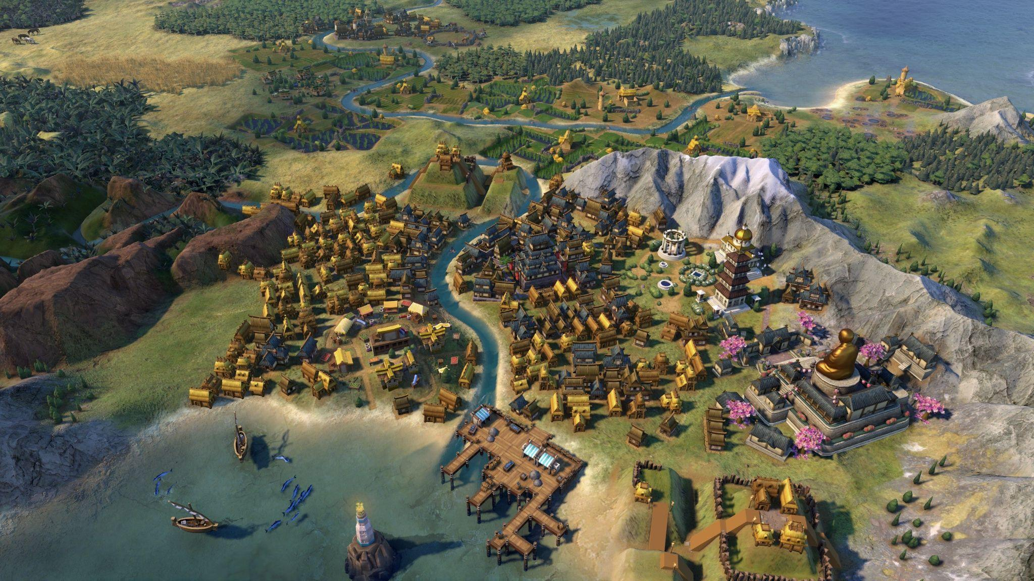
Game References
Notes:
This is Civ 6, it's a great example of how a city will grow over the course of the game. There is variety in the assets used, the rotation, the placement etc.
The buildings are in a slight grid pattern but it's morphed and not completely rigid, the buildings also don't overlap.

Slide 6
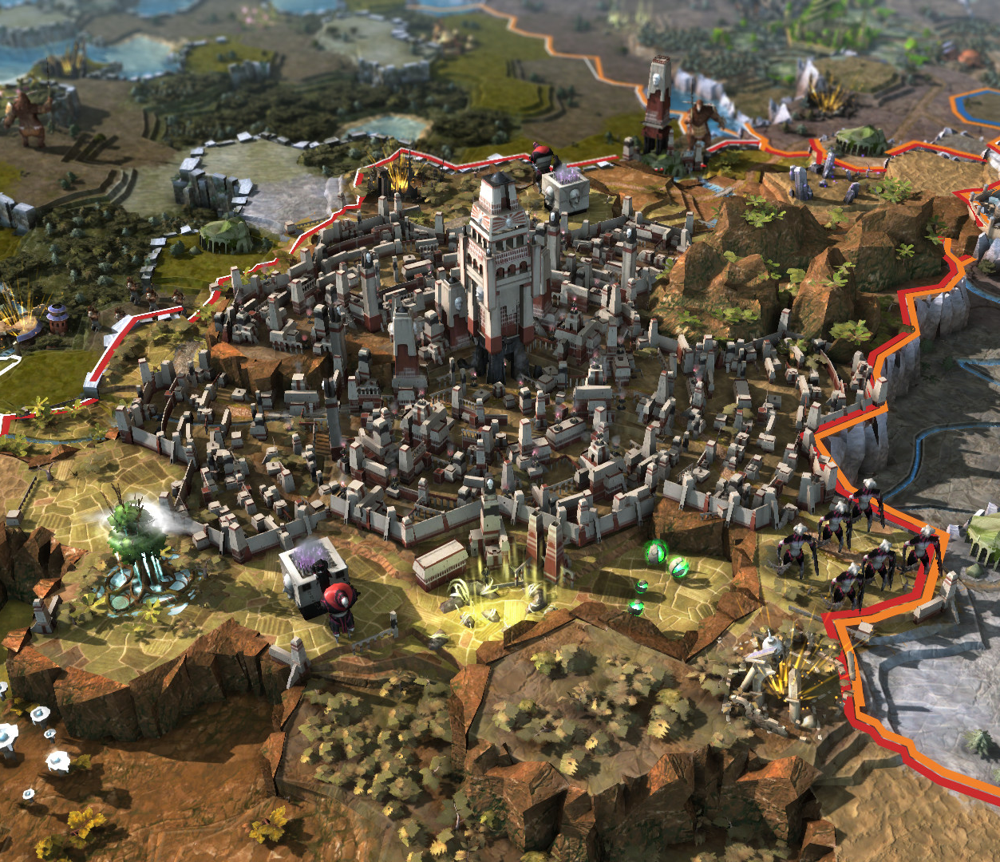
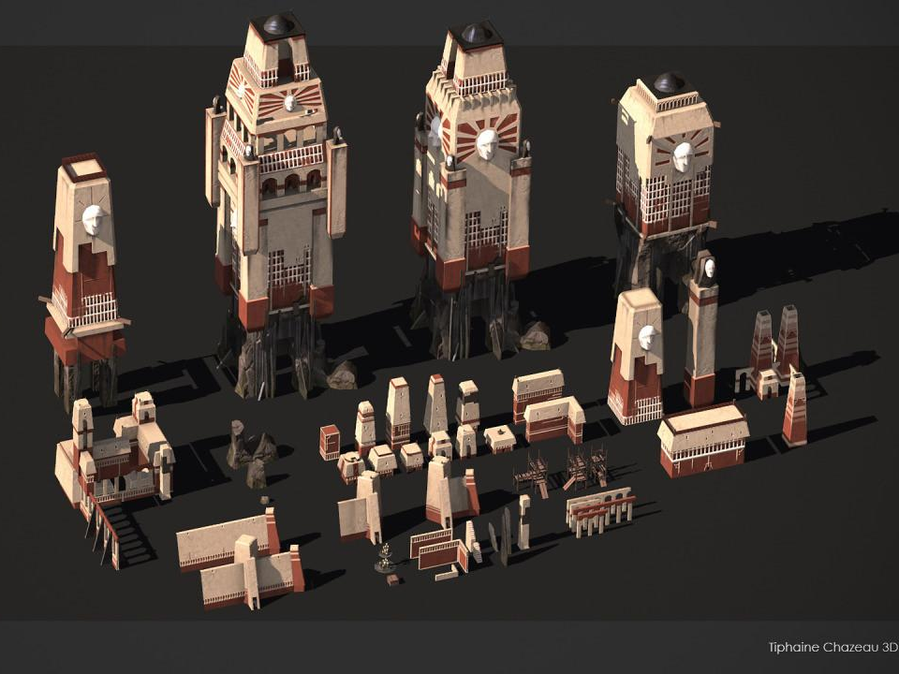
Game References
Notes:
Here we can a great example of having an irregular city where the buildings/assets are not in a simply grid pattern and it gives it much better silhouette again the terrain.
This will be are main inspiration for how we want ours to look.

Slide 7
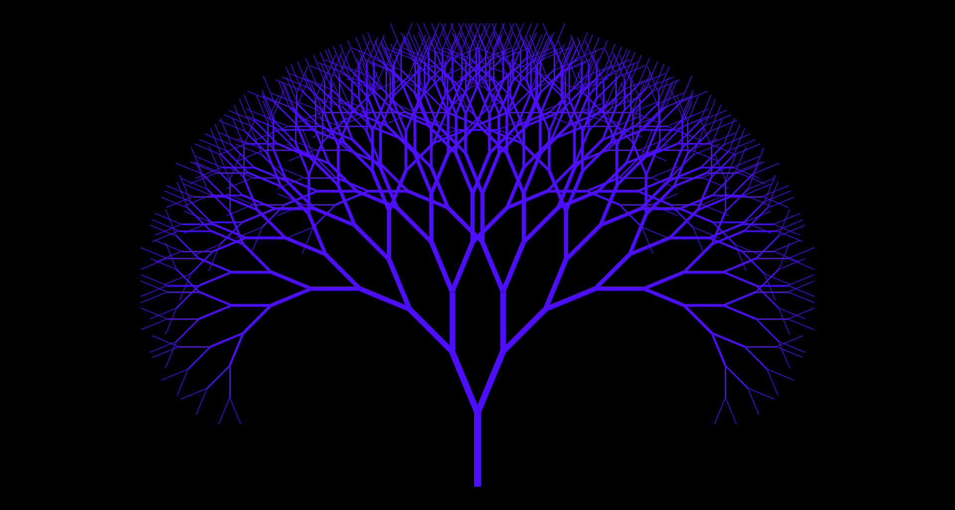
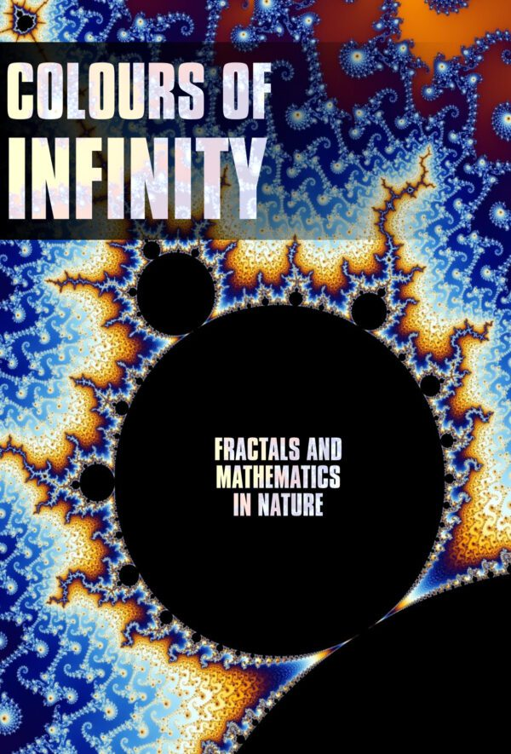
How do we decide where to start
Notes:
For the sake of simplicity let's imagine we just run into the task head fist without consulting other devs and with limited research. In reality the choices we make about our approach deeply affects the outcome and will give us more or less flexibility with the end system and will impact how it looks.
We can think about all the different implementations like branches on tree.
Also this picture on the left is made buying using fractals, using fractals to create a layout could be a cool idea, i recommend watching this documentary on netflix about them.
Okay side tangent over, let's start making some cities

Slide 8
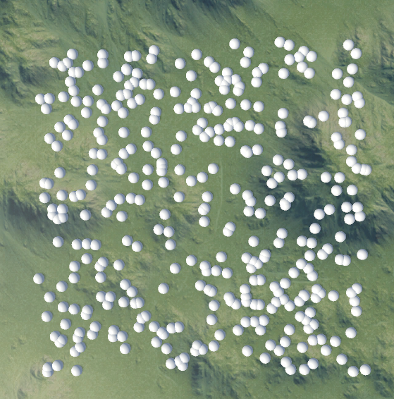
Absolute random spawning
Notes:
To start placing down buildings(houses, taverns, offices, etc), we need to create a point in space where we spawn them in. From now on when i refer to a point it also means building and vice versa.
On this slide is our starting approach, the most basic way to generate a set of points on a field. We select a random number between 0 and lets say 10, for each axis and then just spawn a sphere there to see it. We do this over and over till we have enough points. It looks awful but it's a good start.
But our problem is that these points are overlapping each other, so the question becomes “How do we spawn points on a plane so that they don't overlap”

Slide 9
Research
“How do we spawn points on a plane so that they don't overlap?”
“You want to create some Blue Noise by using a process called Poisson Disc Sampling and you need an algorithm which allows you to do that.”
Notes:
First let's start by looking at what we want to make. We ask around and get this answer by a peer, now we just need to find out what all these new words mean.

Slide 10
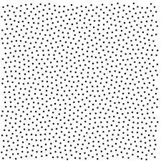
Definitions
Blue Noise
Coined in Digital Halftoning by Dr Robert Ulichney in 1987
an even, isotropic, yet unstructured distribution of points.
Meaning a set of points that are randomly but evenly spaced
Poisson Disc Sampling
Name originates from French mathematician Simeon Denis Poisson. Who introduced poisson distribution in 1837.
Poisson-disc sampling is a process that distributes random samples on a domain of n-dimensional space
based on two pre-defined criteria.
(1) Each sample must be placed randomly according to a uniform density distribution.
(2) The distance between every pair of samples must not be smaller than some chosen distance r
Notes:
You might already be aware of the term noise, white noise, perlin noise etc.
Blue noise is in the same family, it just means evenly spaced distribution without being in a structure such as a grid or hex grid.
Poisson Disc Sampling is going to be the focus of this talk so we need to define that too, it's a process which will generate our noise,
You can think of it as the generic term for the algorithm we will implement, and its criteria are that the points on our noise will be :
that we place our points using a random function
within a minimum distance to each other and that we place our points using a random function.
Using those two criteria we can create some new code that will first, generate a random point , and then check its within a minimum distance to all other points.
NOW, for our purposes were actually okay if our blue noise isn't evenly spaced, just that it's a minimum distance away.

Slide 11
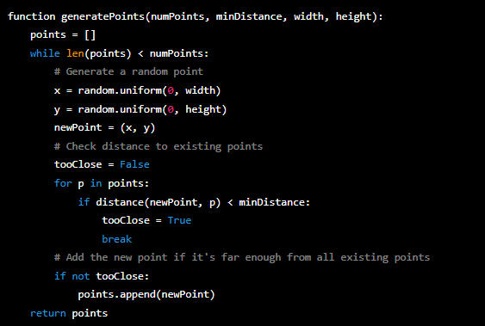
Dart Throwing Algorithm
While we have less points then we need
Create a random point
Loop through all points in the world
Check that the distance between any point and this new point are above a set minimum distance
Add to list so we can check against it when we create a new point
Notes:
Explain code

Slide 12
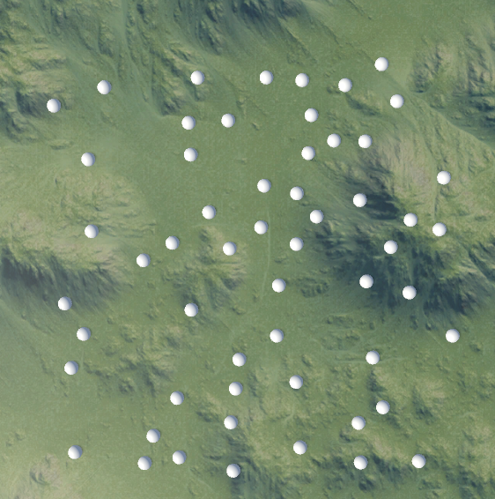
Dart Throwing Algorithm
Notes:
YEAH Good, lets put it up for PR

Slide 13
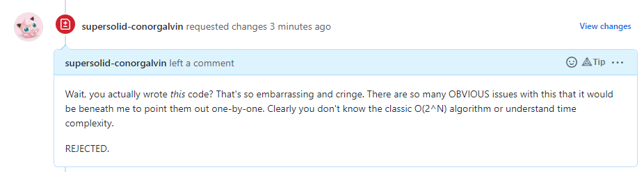
PR feedback
Our main problems are:
Performance
Points are placed randomly still
Notes:
So conor gives us some feedback, let shave a read of that.
Wait to read
Hmm, okay a little harsh.
Okay so what's wrong with the time of our algorithm?

Slide 14
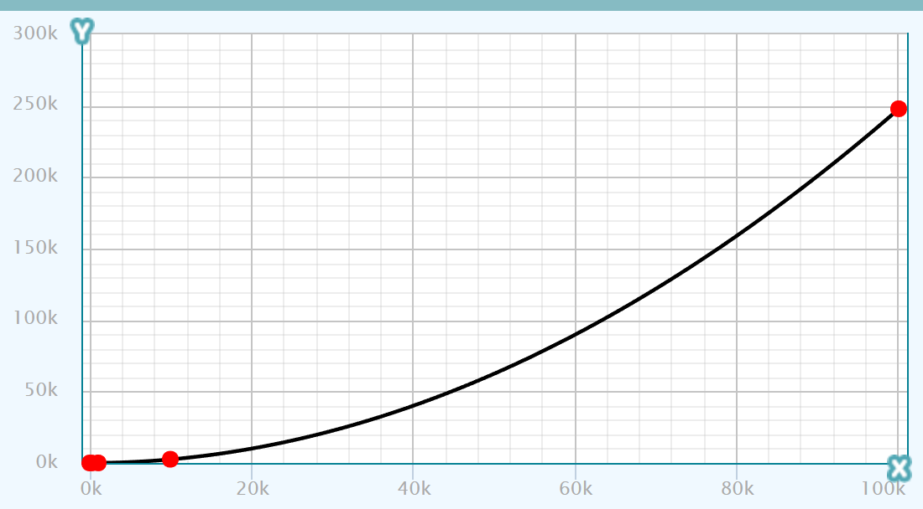
Time Complexity
Time (ms)
Number of points generated
Notes:
If we plot the amount of time in milliseconds it takes for us ot generate points(10,100,1000,100000 etc)
With a small number of points it look fine, but as soon as we increase the amount of points it exponentially increases the time. At 100 thousand points it takes 4 minutes to generate, and this is on quiet good hardware. Realistically a city in our game will never have that many buildings, but let's imagine this code is going to be reused, it should run efficiently in any application and on any device.
Why is this happening? Because when we generate 10 points the 10th point need to do 9 distance checks but at 1000 points the last point needs to check against 999 other points before it can be placed. If its successful.
We need a faster solution. Is there a way to do less comparisons when we have lots of points?, yes there is

Slide 15

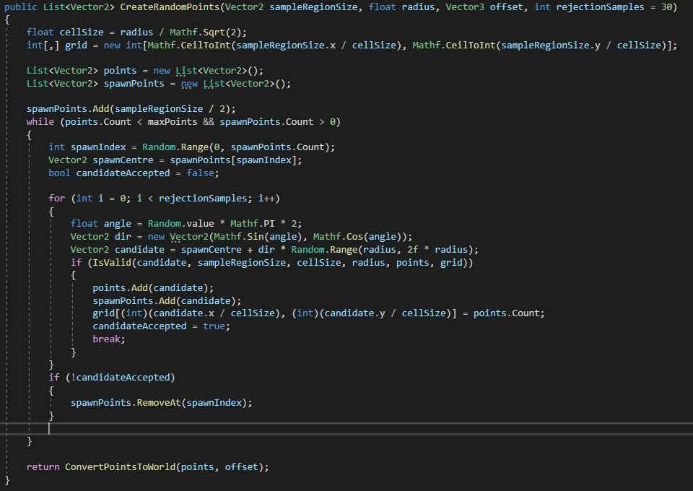
Bridson’s Algorithm
Create a grid based on cell size (radius)
Create an open and closed list. Add first point to open list
Select random point already added
Create a new point at angle and distance away
Check if its valid to place. If it is we add to closed list, else we keep making new points to check
Notes:
Explain a little, mainly on the way we now generate points from existing points rather than throwing at a random position.

Slide 16
Bridson’s Algorithm
5m
1m
No point can exist within this points radius
5m
The length of the circle's minimum radius
Notes:
Let's imagine this example. We have 4 buildings already placed on our city, we then want to add a new one. This new building needs to be at least 1m away from any other building. And we assume that all other points are also at least 1m away from each others
This is all happening within an area of 5m by 5m In this example we are creating this point from the blue dot on the left.

Slide 17
Bridson’s Algorithm
= 1m
= 0.707m
5m
= radius
5m
Number of grid cells (in each axis)= length / cellsize
(Rounded up)
Cellsize = radius / Sqrt(2);
Therefore we have 8 cells because 5m/0.707m = 7.07m
Which we round up to 8
Notes:
First we are going to divide this are up into a grid, we are going to use the 1m value as the basis of the gridcells. Let's imagine the radius (1m) is equal to the hypotenuse of each individual grid cell.
That would mean each cell is 0.7 by 0.7.
We create a grid that is 8 by 8 (64) because the 5/0.7 = 7.07 then rounded up. CLICK Next let's imagine that are grey point isn't near the middle of the cell but instead in the corners.
CLICK If we overlap the radius of 1 m we reach the corner of the neighbouring cells and then extend over more cells by a little. CLICK
If we take the whole area under the combined orange circles we have a limited list of all cells that could possibly overlap our grey point

Slide 18
Bridson’s Algorithm
= 1m
= 0.707m
5m
Compared to Dart throwing we only need to compare at most with 21 points, but realistically a lot less
5m
Notes:
When looking at this we now have confidence that we can only even be overlapping the existing cells in the white cells. We can then do our usual distance check to know that the red point is too close, meaning our grey point cannot be placed. Compared to

Slide 19
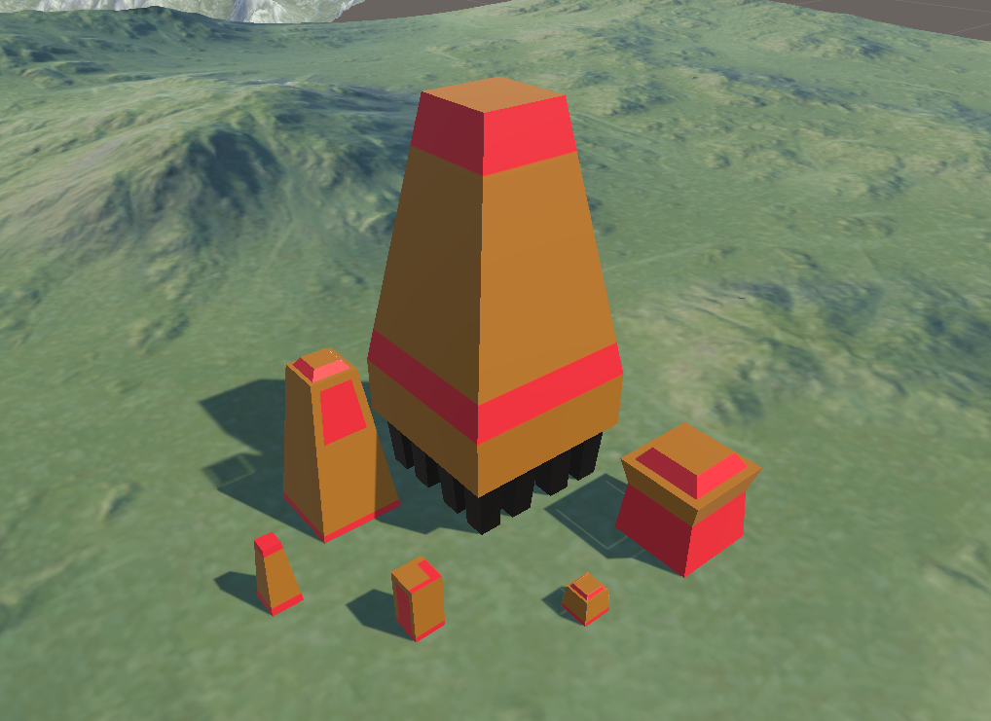

Slide 20
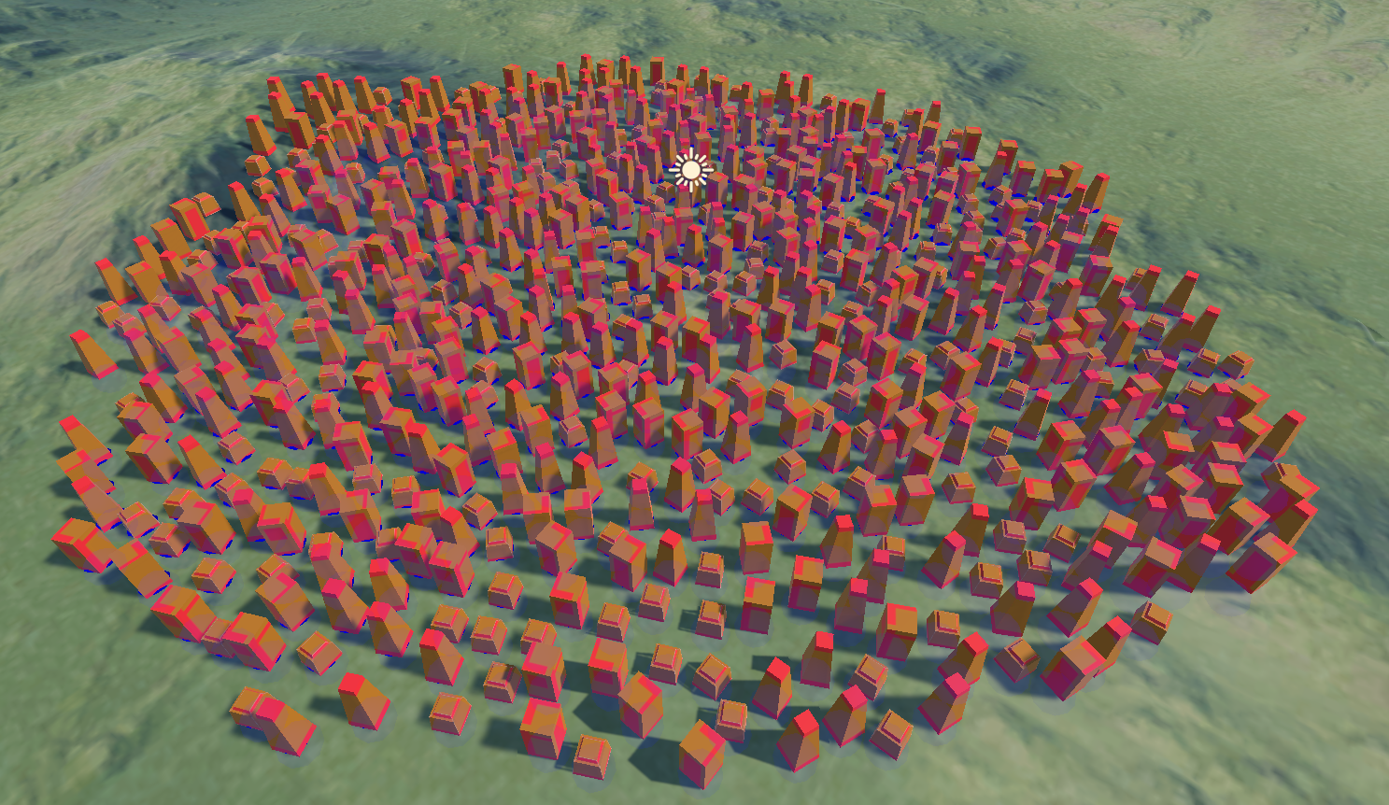
Bridson’s Algorithm
Notes:
Here it is in action!
Like i said the points now generate from existing points so it has a nice growing effect.
We can see that all the buildings we have are evenly spaced.
And we can use some unity gizmos to check this too

Slide 21
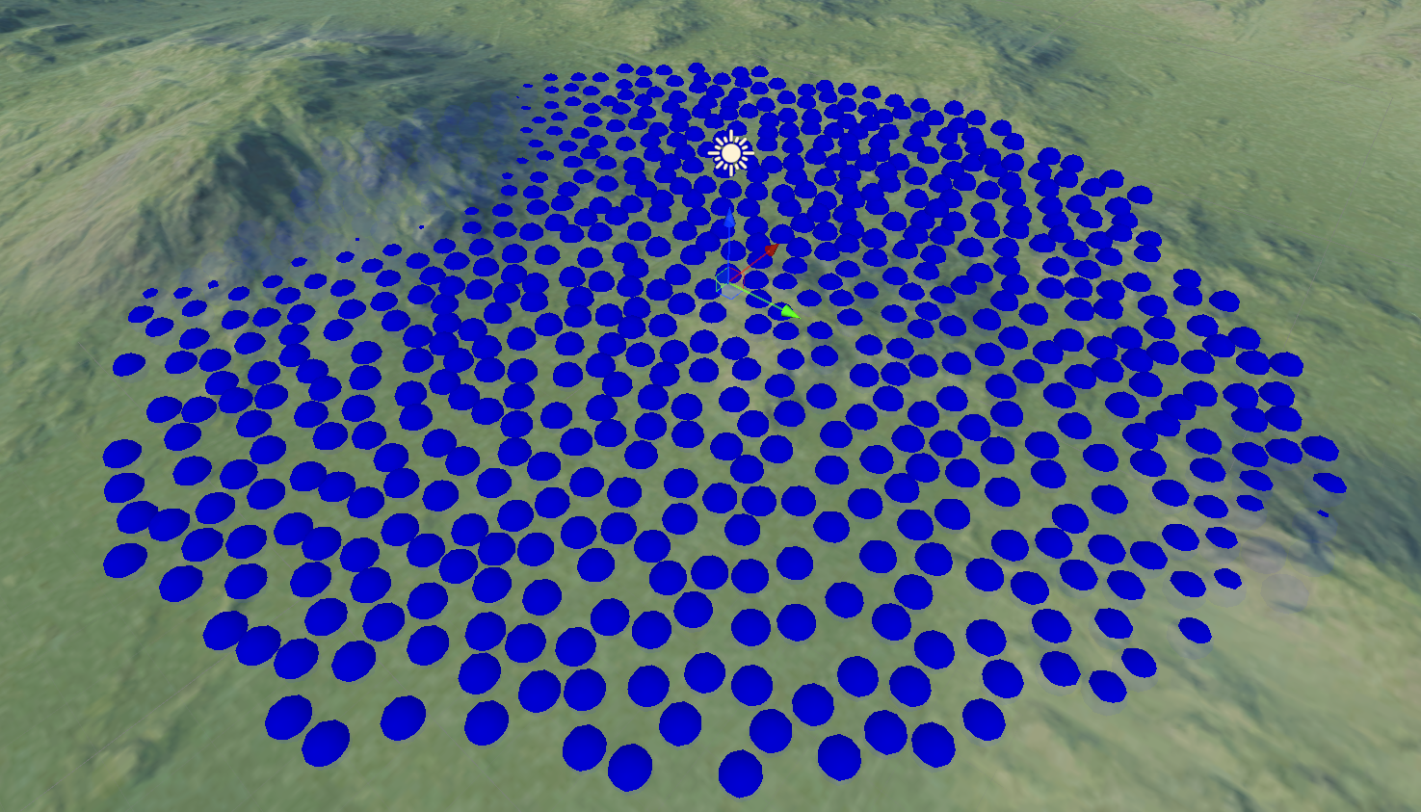
Bridson’s Algorithm
Notes:
Here i'm just displaying the radius of the points on the left, and we can visually see no overlaps. Some are hidden behind the hill but its not a problem.

Slide 22
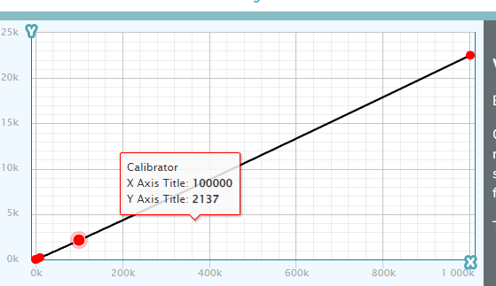
Time Comparison
Notes:
When comparing the two the shape of the graph is interesting.
On the left the time taken per point is growing. whereas on the right the time taken for each point is the same. And the time taken to make 100 thousand points with our new algorithm is 120 times quicker.
SUCCESS!
We then add some functionality to change the spheres to different gameobject and change the distance between buildings so it can be swapped in the inspector.

Slide 23
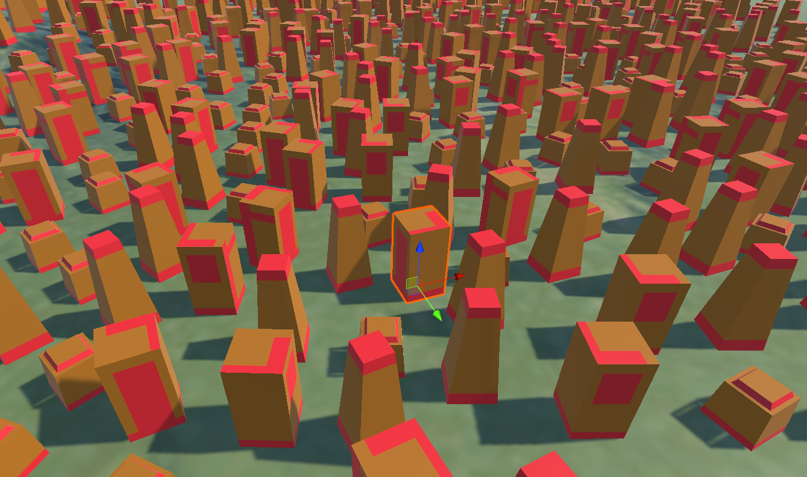
Design feedback
They want some buildings to be wider/ have more space
Notes:
We are happy with our new implementation, we get it checked by devs and they are happy with code quality. But when we hand it to the designers and they replace the spheres with their prototyping models they are not happy. The city looks very samey, they wanted to be able to use different sized models but those would either overlap or be too far apart.
Now we need to make our algorithm work with multiple distances. How do we do that since we make a grid based on an assumption that all the radii of our points are the same.

Slide 24
Variable radii
= 2m
= 1m
= 0.707m
5m
5m
= minimum radius
Length of search cells = (radius/gridcell length)(rounded up)*2 + 1
(1/0.707)rounded*2 + 1 = 5
5m
5m
(2/0.707)rounded*2 + 1 = 7
Notes:
Now we say that 1m is our base radius, meaning no other radius can be smaller than 1m, this is what we use to create the grid and so it wont change.
Well let's consider a new point on our grid. We've added more points now with different radii.
And for this example we want to place down a point that is 2m radiu (min distance) instead of 1m.
CLICK
Again we cna imagine all the possible places it can be , and now we see the line overlaps more cells in our grid.
CLICK
And that the area under our circle is larger than before. But we can actually use a simple solution to work ou the number of “white cells” that we need to check. Lets take the radius(2) and then divide it by the cell size we already had, 0.7. If we round that up we get the number of cells away from the center we need to search. Double it for the diameter and add 1, the staring cells, and we get the length of are we need to search.

Slide 25
Variable radii
= 2m
= 1m
= 0.707m
5m
5m
= minimum radius
Length of search cells = (radius/gridcell length)(rounded up)*2 + 1
(1/0.707)rounded*2 + 1 = 5
5m
5m
(2/0.707)rounded*2 + 1 = 7
Notes:
So before we searched a are of cells of 5x5 but now we search an area of 7*7. Important to note is that this means we can't use a radius that is less than 1.
So from now on we need to define a minimum grid radius which all other radius must be larger than.

Slide 26
Variable radii
5m
5m
Min radius is allowed to overall?
5m
5m
Notes:
So if we see the radius of the other points overlapping it might look like we messed up, click

Slide 27
Variable radii
Min radius is allowed to overall?
Notes:
But when checking we see each point is within its minimum distance. For The SIZE of the buildings we actually need to use the radius/2 to get a size that won't overlap

Slide 28
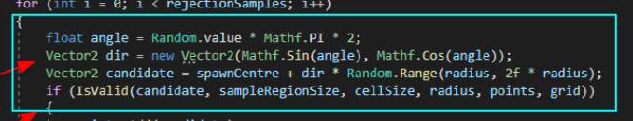
Variable radii
Notes:
Looks good, if we wanted to change the degree of extra space we have and have it be a tighter packed set of points how would we do that?
Earluier on i showed this code, which generates candidate points at a distance of between radius and 2*radius. But we can change that 2 to have our points be more or less packed in.

Slide 29
Dwork fast variable radii
5m
5m
 |  | 1 | 1 | 1 | 1 | 1
 | 1 | 1 | 1 | 1 | 1 | 1 | 1
 | 1 | 1 | 1 | 1 | 1 | 1 | 1
 | 1 | 1 | 1 | 1 | 1 | 1 | 1
 | 1 | 1 | 1 | 1 | 1 | 1 | 1
 | 1 | 1 | 1 | 1 | 1 | 1 | 1
 |  | 1 | 1 | 1 | 1 | 1
 |  | 1 | 1 | 1 | 1 | 1
 | 1 | 1 | 1 | 1 | 1 | 1 | 1
 | 1 | 1 | 1 | 1 | 1 | 1 | 1
 | 1 | 1 | 1 | 1 | 1 | 1 | 1
 | 1 | 1 | 1 | 1 | 1,2 | 1,2 | 1,2
 | 1 | 1 | 1 | 1,2 | 1,2 | 1,2 | 1,2
 |  | 1 | 1 | 1,2 | 1,2 | 1,2 | 1,2
 |  |  |  | 1,2 | 1,2 | 1,2 | 1,2
5m
5m
Notes:
Last point on the technical side. We can go a step further and instead of searching through cells to find points to check. Instead we can push the id of each point into the cells it surrounds, Then we add in a new point we can look at that cell, see all points it surrounds and do a direct check. Basically we move our for loops into a different place and make it simpler to compare.

Slide 30
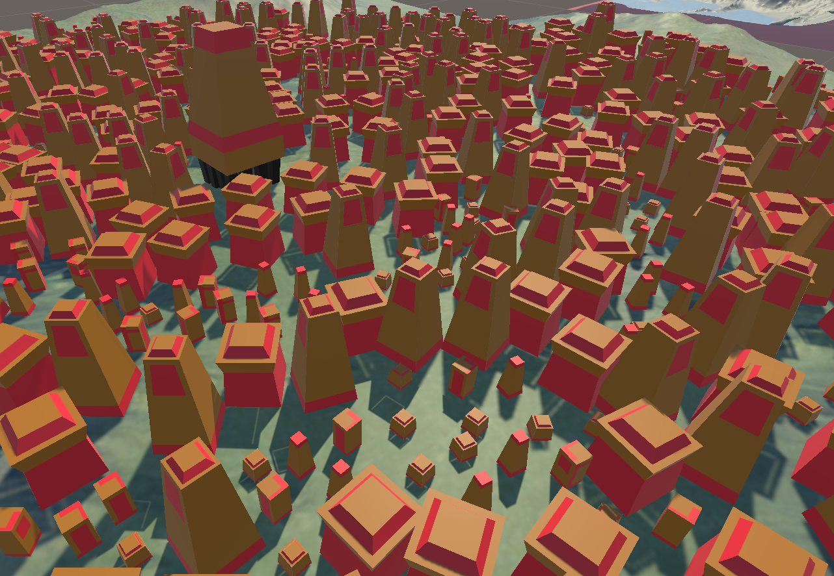
Working
Notes:
Finally lets see it in action!

Slide 31
Dwork fast variable radii
Show ms improvement https://www.ncbi.nlm.nih.gov/pmc/articles/PMC7878411/
https://www.youtube.com/watch?v=ITsvn4wAvCw&ab_channel=NicholasDwork

Slide 32
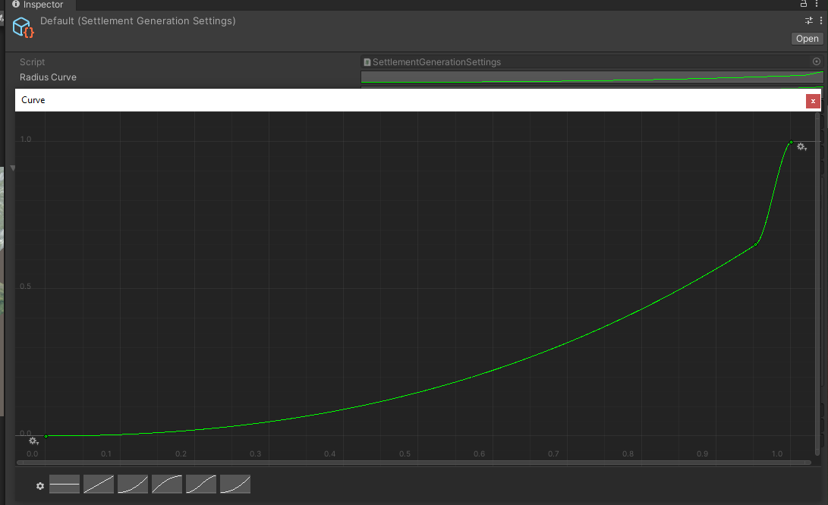
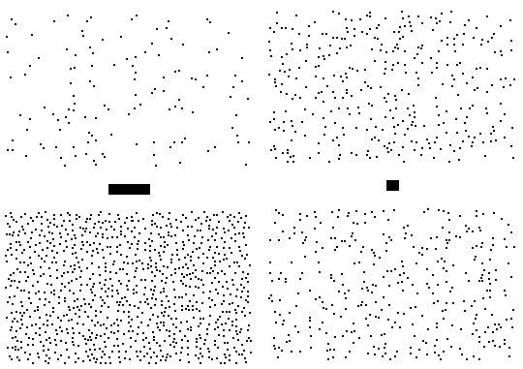
How do we decide which points/building have larger radii
Notes:
Now we can quickly create a area with random points that have different density and won't overlap. Perfect, but how do we decide which points are more or less dense? For our purpose we want the city center to have larger buildings which requires more space, and the slums on the outside to be smaller at their base. We can use the distance to the center of the city as a sample.
Where a distance of 0 == largest possible radius and 1 means lowest radius.
But for this i've gone one step further, i instead use that value to lookup the density on curve, given me greater control of the city.

Slide 33
In Action
Notes:
Finally lets see it in action!

Slide 34
Adding some noise to our density sampling

Slide 35
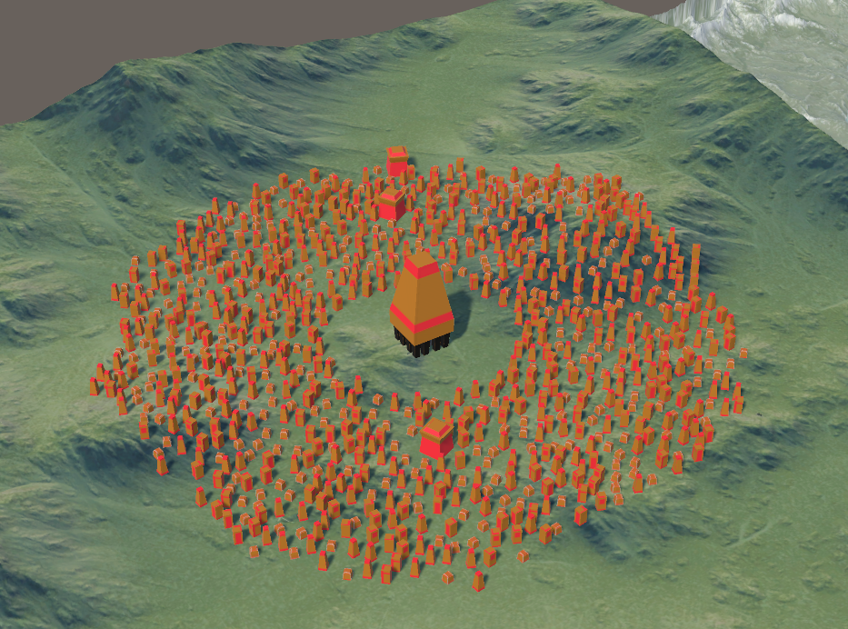
Adding override system for evolving city

Slide 36
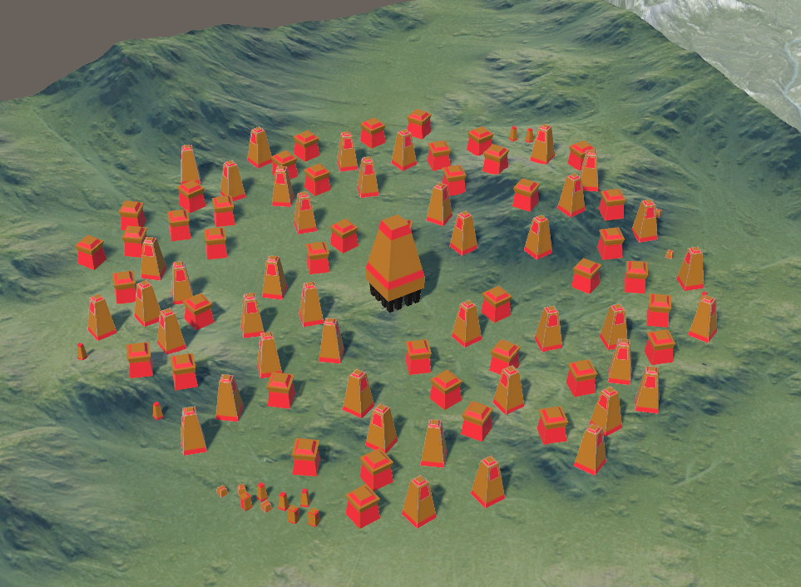
Adding override system for evolving city

Slide 37
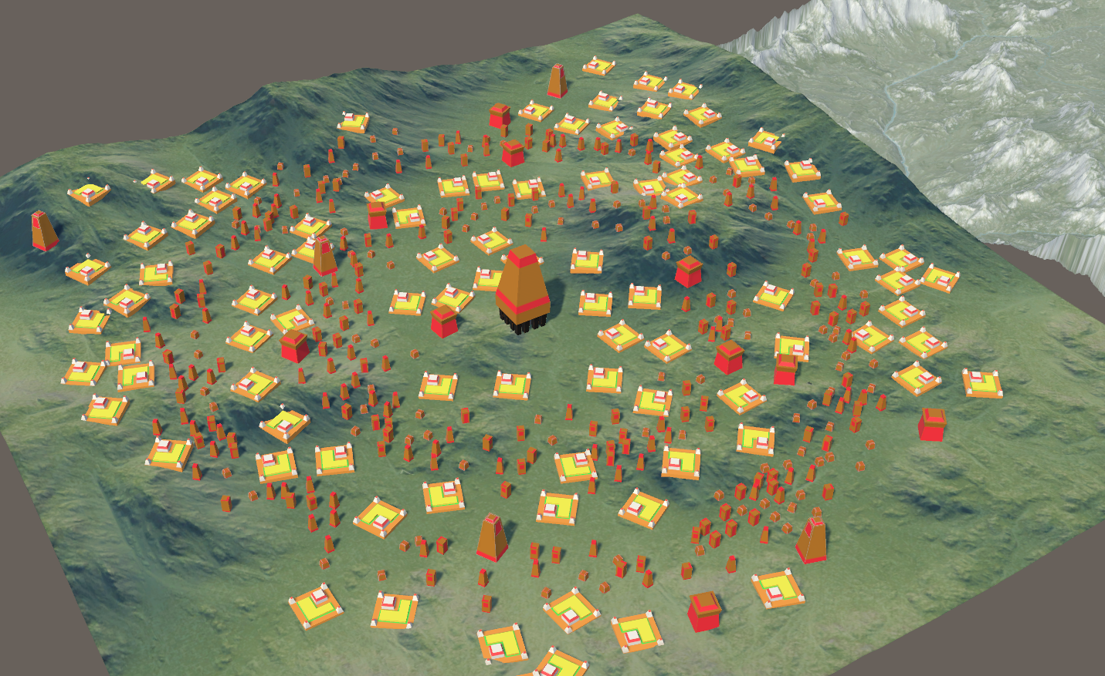
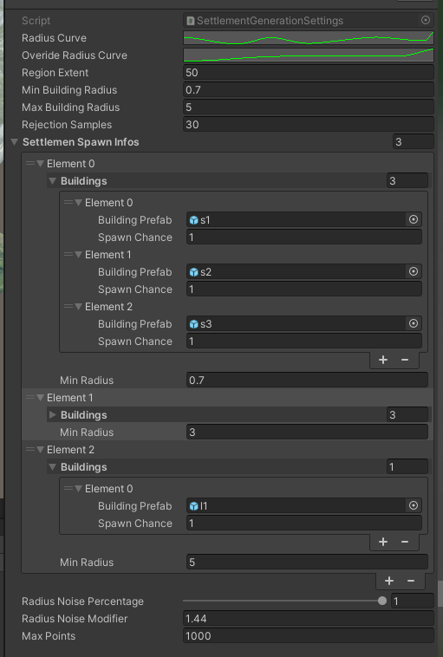
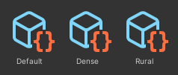
Customisation

Slide 38
Demo?

Slide 39
Future Stuff
Conforming to with terrain better/bodies of water
Adding aqueducts
Adding walls
Adding roads
Adding foliage

Slide 40
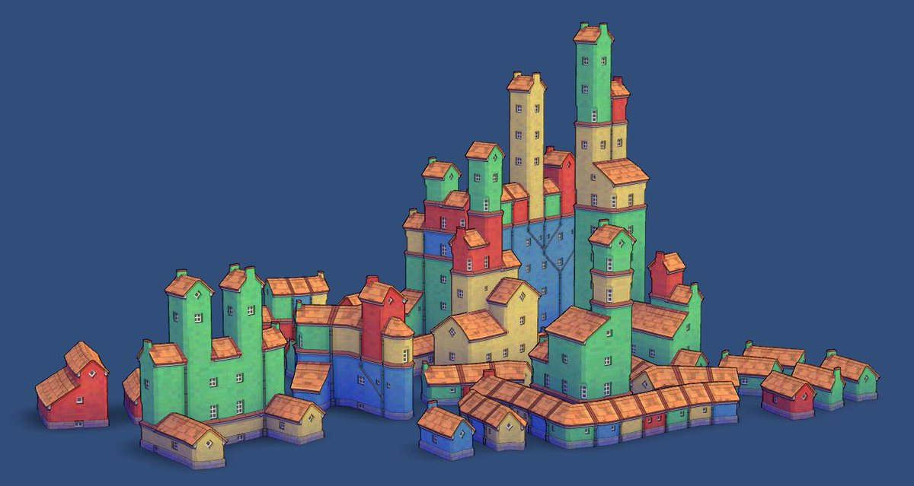
Other Branches

Slide 41
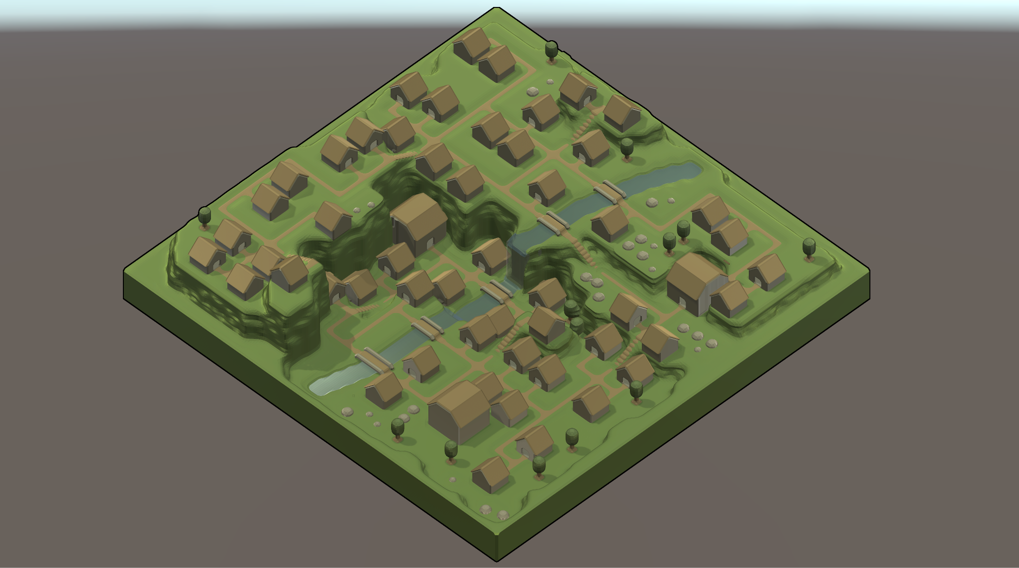
Other Branches

Slide 42
Fast algorithm problem
Can you spot the problem? SHow image

Slide 43
OR we could have done this
Idea -> explanation -> problem -> remove idea
Create texture(heightmap) with density and use x,y coord to instantiate asset position. -> will need multiple textures for variation, not easy to change specifics.
https://watabou.itch.io/medieval-fantasy-city-generator
https://github.com/zulfajuniadi/TownGenerator
https://watabou.itch.io/city-viewer
https://forum.unity.com/threads/town-maker-procedural-village-town-city-generator.313197/
https://www.google.com/url?sa=i&url=https%3A%2F%2Fwww.youtube.com%2Fwatch%3Fv%3D0bcZb-SsnrA&psig=AOvVaw3xrw68BaxRGxhshjTm0vJK&ust=1677463596918000&source=images&cd=vfe&ved=0CA8QjRxqFwoTCOjAnICNsv0CFQAAAAAdAAAAABBO

Slide 44


